Slide 1

Case Discussion
Mr. X had a bad day ☹
After a long day work, Mr. X realized he had a worst day !
He is driving back to home. He lives in a Villa in a gated community.
Before taking a turn to his home he hits the flowerpot and fences of the neighborer.
He himself also happens to get bodily injury, bruises on his arms.
Once at his villa boundary, He Opens the campus gate, drives on walkthrough pavement,
parks the Car. He was rubbing the fresh bruise and happens to hits the Kennel.
Gets in the home and prepares some coffee and relaxes to watch TV.
The coffee spills over the costly painting kept there….
To change his mood and get some fresh air he moves in the attached balcony.
Looks at the flowers and flowerpots kept in the terrace.
He leans to pluck a flower; the flowerpot loses balance, and it falls over a
passing underneath stranger. He bangs his head with frustration.
Has Home insurance got a solution to his frustration?

Slide 2

Role Play
One of the attendees becomes a homeowner
Another becomes neighbourer
They mesh up with each other as, the one has hit another’s fence.
What would be owner’s worry?
What would be neighbor's worry?

Slide 3

PL- Homeowners/Renters Program
Homeowners Program is designed to provide Insurance protection for Homeowners and Renters.
HO Program provides protection for Residence Damage, Personal Property damage, Private Structures damage, Loss of Income and Liability
Homeowner's policy provides coverage for the house, the garage and other structures on the property, as well as personal possessions inside the house such as furniture, appliances and clothing, against a wide variety of perils. The extent of perils covered depends on the type of policy

Slide 4
Do Watch…
Visit without fail
Basic Home Insurance Information- https://youtu.be/bic4qOuIJoI
Homeowners Insurance - 8 Types - https://youtu.be/QFbkOnErE6A
Insurance 101 - Homeowners Coverages https://youtu.be/bic4qOuIJoI
What Determines the Cost of Homeowners Insurance? https://youtu.be/rMDQVIe6zds
Replacement cost and market value - https://youtu.be/VgYTBNgKG3w
HO3 vs. HO5 - The Difference- https://youtu.be/MsoFGntjbmY
Detailed explanation: https://youtu.be/DJfgVaeQANU,

Slide 5
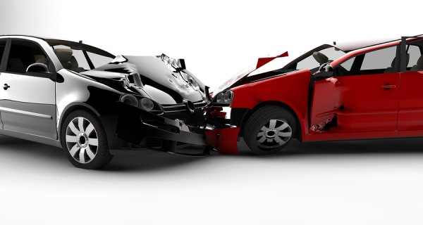

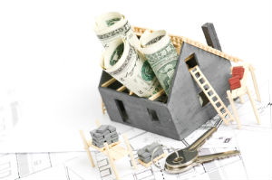
Common Homeowners Coverages
Property Coverages
Liability Coverages
Other Coverages

Slide 6
Property Coverages
Property Coverages
Cov- A-Dwelling (attached)
Cov B- Other Structures (10% of Cov. A limit) (detached)
Cov C- Personal Property ( 50% of Cov A limit)
Cov D- Loss of Use ( 30% of Cov A limit)

Slide 7
Liability Coverages
Liability Coverages
Cov E-Personal Liability--- for third party BI/ PD claims
Cov F-Medical Payments to Others--- medical expenses
incurred by others

Slide 8
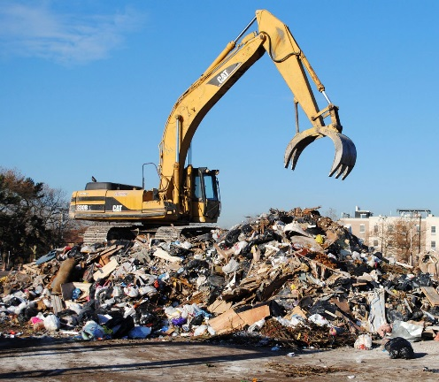
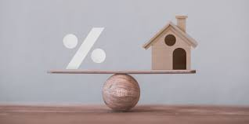
A few Other Coverages
Other Coverages
Scheduled Personal Property
Removal of Debris
Inflation Guard

Slide 9

Removal of Debris
Provides reimbursement for clean-up costs associated with damage to a property
Typically, only cover debris resulting from an insured peril, such as charred wood
from a building fire.
It covers the cost of :
(1) Removing the debris,
(2) Dismantling or pulling down the damaged parts of the structure, and
(3) Of shoring up the structure. Such costs are usually limited to 5% to 10 % of
the face amount of a policy.

Slide 10
What is Scheduled Personal Property?
It's an optional add-on to your homeowner's insurance policy
Increases the limits on specific high-value items for more protection.
They are agreed value settlement.
Some belongings you might want to consider for scheduled personal
property coverage as 1. Jewelry and furs 2. Art and antiques 3.Stamp or coin collections 4. Musical instruments 5.Expensive cameras
The Benefits of Scheduling Valuables ( Ex -All State)
1, Broader protection: Covered for additional risks, including accidental loss (like dropping your wedding ring down the drain), breakage and mysterious disappearance which typically isn't something covered by a standard homeowner's policy.
2, No deductible. When you have a claim on an item that you have scheduled, you're usually not required to pay a deductible. That may not be the case for other belongings that fall under the protection of personal
property coverage on your standard policy.

Slide 11
Inflation Guard
Inflation guard provision:
Insurance that intermittently increases in value in order to keep a realistic amount of coverage, due to the rapidly inflating cost of building materials. Its an optional endorsement that :
Protects the rebuilding cost of your home.
Automatically increases the amount of insurance on your home.
Increases a certain percentage each year to account for the disparity caused by inflation.
It’s a provision that gradually and continuously increases the limit of insurance by a specified percentage over a specified time period (such as 3 percent every 3 months)

Slide 12
Do Watch…
Visit without fail
Basic Home Insurance Information- https://youtu.be/2LC8OaePrFk
Homeowners Insurance - 8 Types - https://youtu.be/QFbkOnErE6A
Insurance 101 - Homeowners Coverages https://youtu.be/bic4qOuIJoI
What Determines the Cost of Homeowners Insurance? https://youtu.be/rMDQVIe6zds
Replacement cost and market value - https://youtu.be/VgYTBNgKG3w
HO3 vs. HO5 - The Difference- https://youtu.be/mKVYW5nAGxA
Detailed explanation: https://youtu.be/DJfgVaeQANU,

